Slide 1

The Demand for Money
and the Price Level

Slide 2
Concepts of Money
Fiat money has value due to government fiat（法令）, rather than through intrinsic value.
Commodity money, such as gold and silver coins, which do have intrinsic value.
High-powered money, which adds the deposits held by banks and other depository institutions. At the central banks, another name for high-powered money is the monetary base （基础货币）.

Slide 3
Concepts of Money
Monetary aggregate
  A monetary aggregate is the total nominal stock of a group of financial assets defined to be money. The most common definition, called M1 = Currency + Checkable deposit
  Currency is held by the public, M0
  Checkable deposits （企业和个人的活期存款）issued by banks and other financial institutions.
  2023年，我国M0=11.34万亿, M1= 68.05万亿, 对照我国GDP = 126.06万亿。M1/GDP=0.539，M0/GDP= 0.089

Slide 4
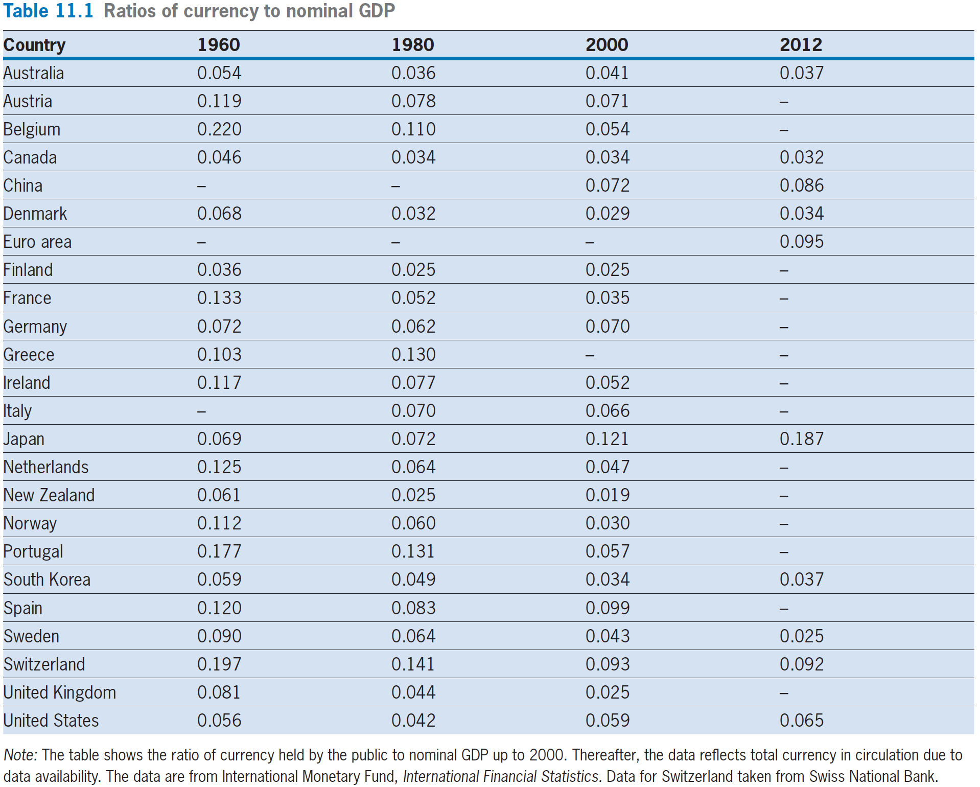

Slide 5
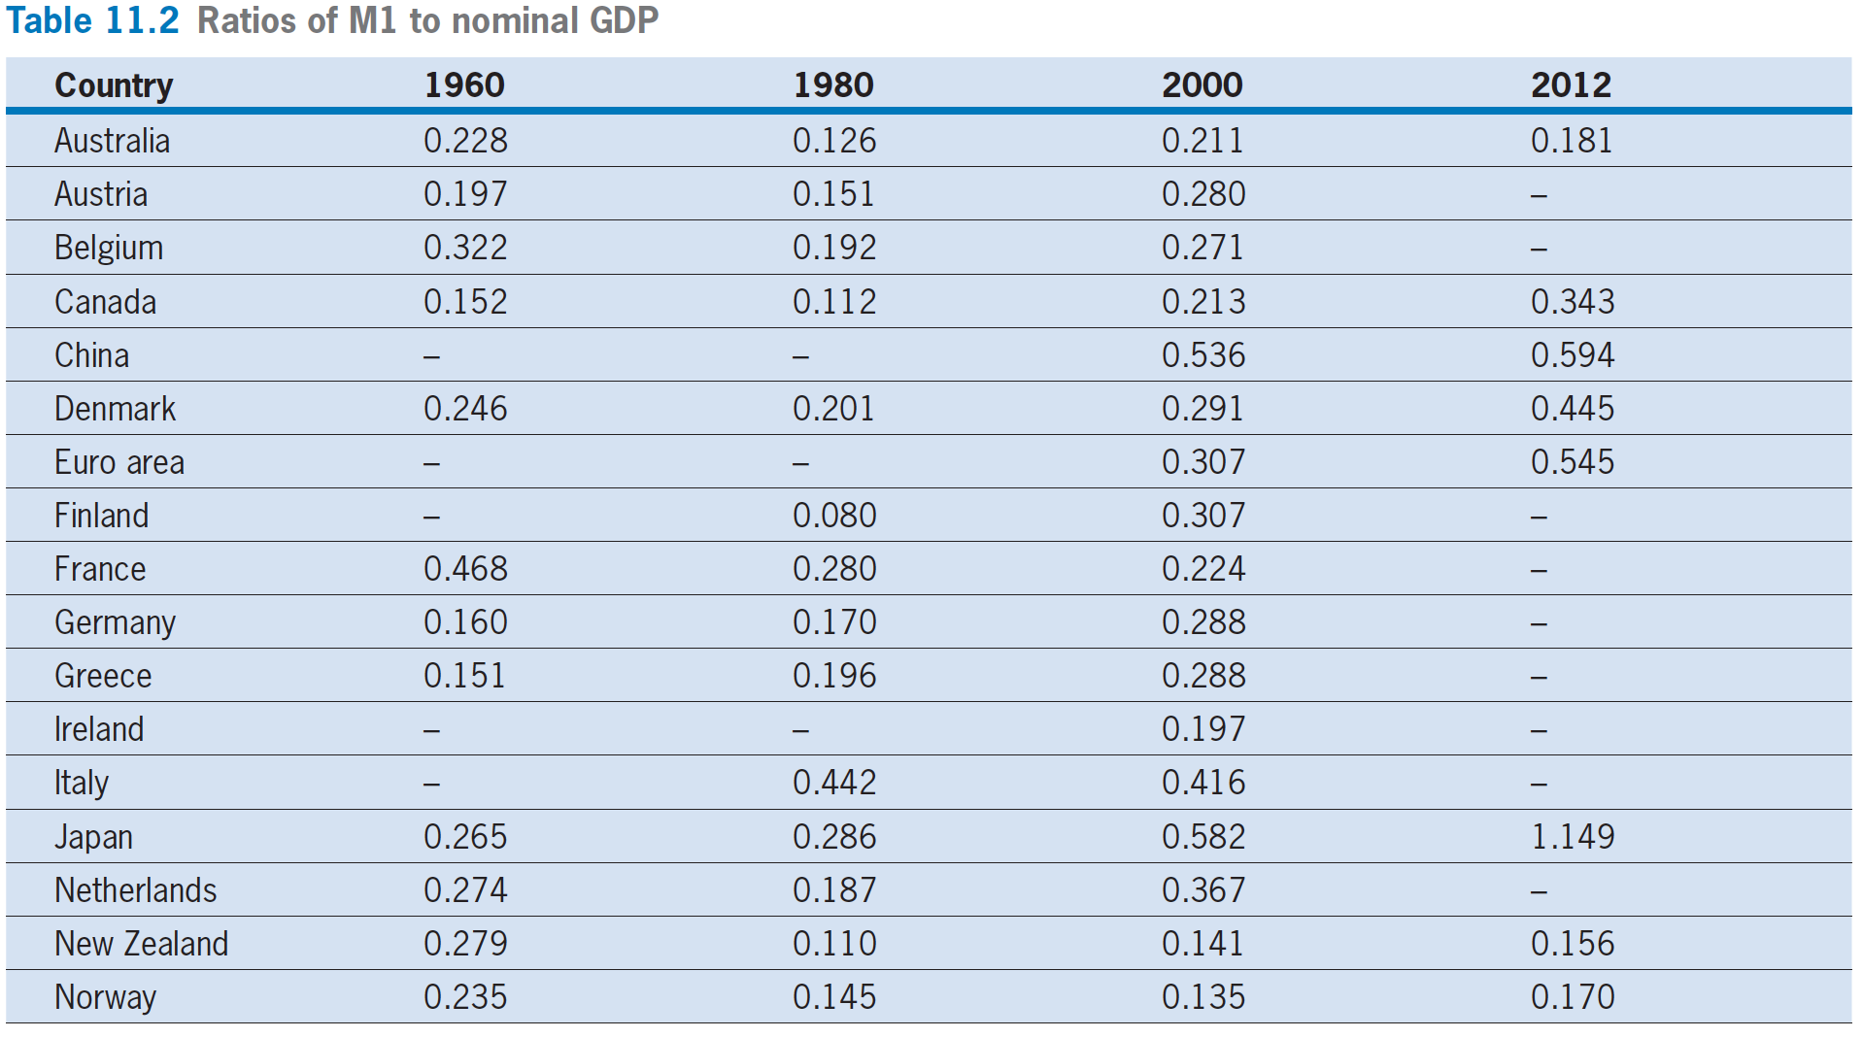
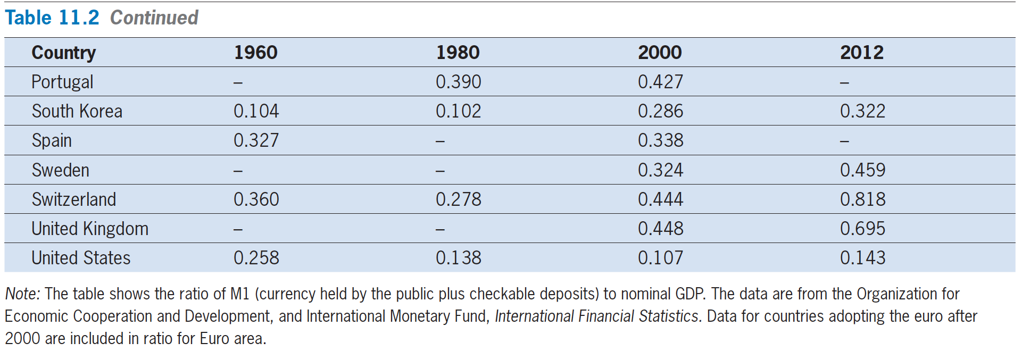

Slide 6
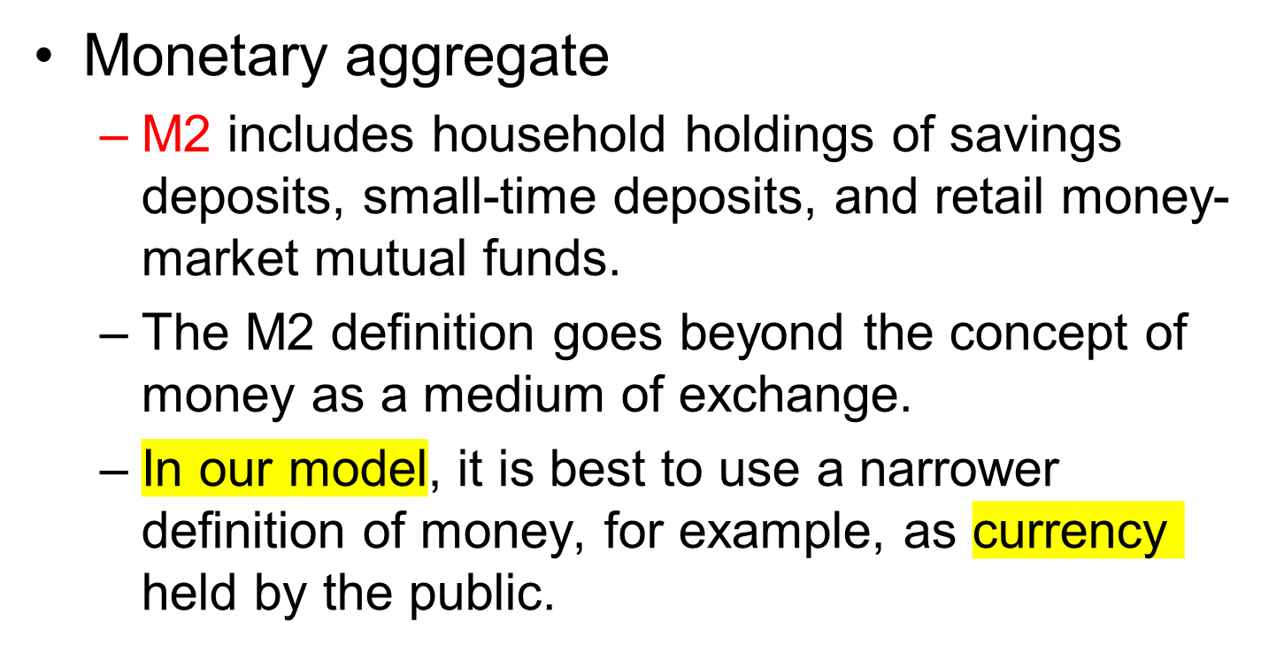
Concepts of Money

Slide 7
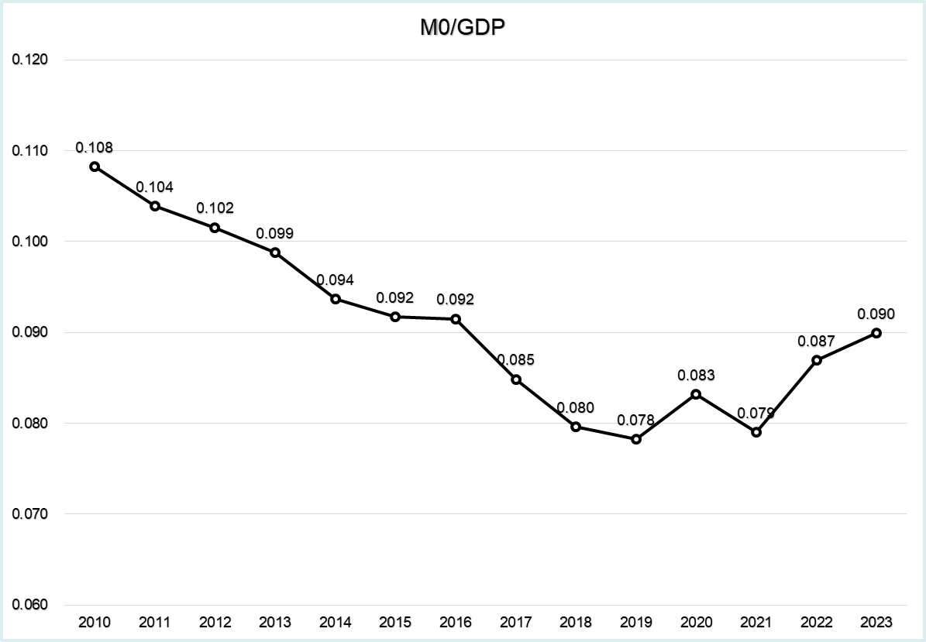

Slide 8
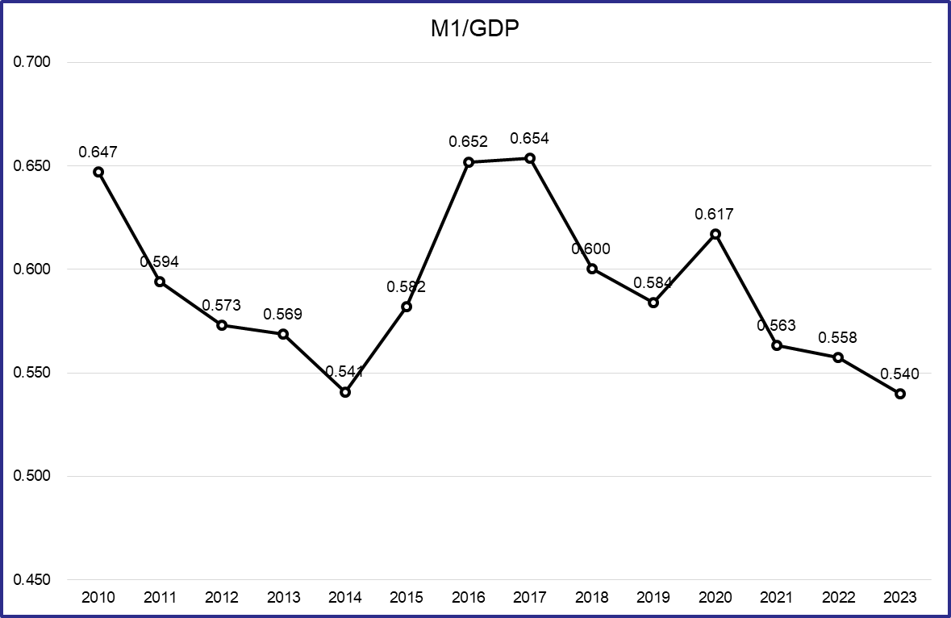

Slide 9
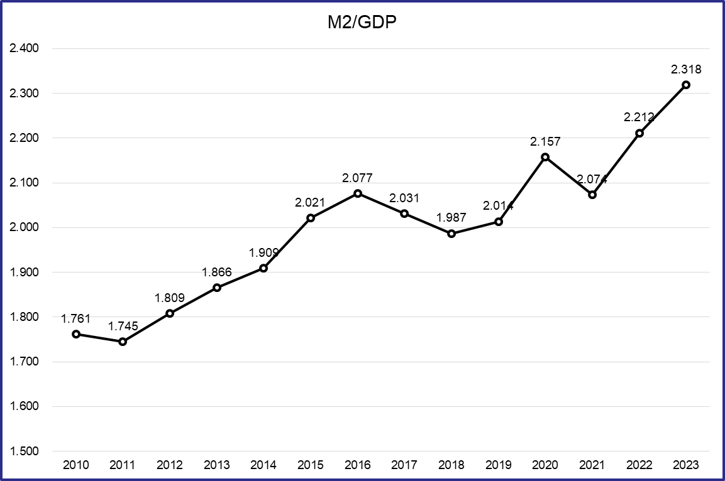
M2增加很多，但是M1和M0却没有，说明很多钱在银行系统空转，没有从银行系统流通出去进入到经济中运转。

Slide 10
The Demand for Money
Money is hand-to-hand currency
  Assume that the interest rate paid on money is zero-interest.
Bonds and ownership of capital
  Interest-bearing assets
  These assets pay a positive return to holders.

Slide 11
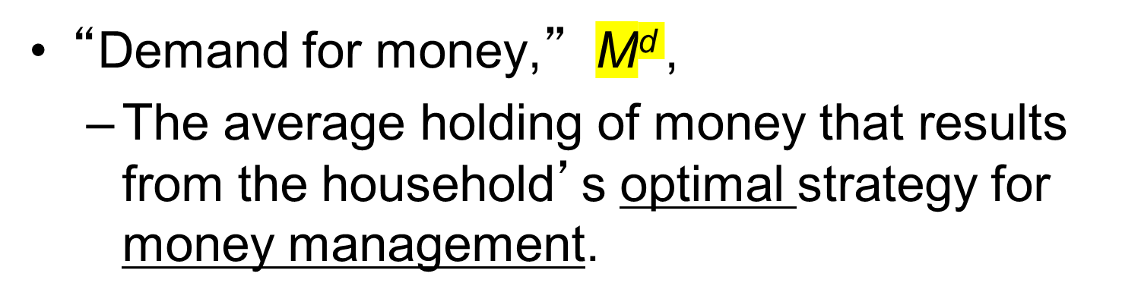
The Demand for Money

Slide 12
The Demand for Money
The household budget constraint in nominal terms
PC + ∆B + P·∆K = wL + i · (B+ PK)
  nominal consumption + nominal saving = nominal income
  the price for Bond is 1.

Slide 13
The Demand for Money
The Interest Rate and the Demand for Money
  A higher interest rate, i, provides a greater incentive to hold down average holdings of money, M, in order to raise average holdings of interest-bearing assets, B + PK.
  With a higher i, households are more willing to incur transaction costs in order to reduce M

Slide 14
The Demand for Money
  We predict, accordingly, that an increase in i reduces the nominal demand for money, M^{d}.
  For a given price level, P, we can also say that a higher i lowers the real demand for money, M^{d}/P.

Slide 15
The Demand for Money
The Price Level and the Demand for Money
  Suppose that the price level, P, doubles. The nominal demand for money, M^{d}, doubles. Since M^{d} and P have both doubled, the ratio, M^{d}/P, is the same.
  The result is that the real demand for money, M^{d}/P, does not change when P changes.

Slide 16
The Demand for Money
Real GDP and the Demand for Money
  Assume now that the real GDP doubled，while the price level, P, is unchanged.
  Households would double their nominal demand for money, M^{d}. Since P is constant, the real demand for money, M^{d}/P, also doubles.

Slide 17
The Demand for Money
Other Influences on the Demand for Money
  Payments technology （支付方式越先进，货币需求就越低）
  The level of transaction costs（资产的交易成本越低，Bond的需求就越大，货币的需求就越低）

Slide 18
The Demand for Money
The Money-Demand Function
  M^{d} = P·L(Y, i)
  M^{d}/P = L(Y, i): real money demand function
  和 P 正相关
  和 Y 正相关
  和 i 负相关
  此处的 L 不是劳动力，是货币需求函数。

Slide 19
The Demand for Money
Empirical Evidence on the Demand for Money
  Steven Goldfeld: a 10% increase in interest rates reduces the demand for M1 in the long run by about 3% (1973,1976)
  Jack Ochs and Mark Rush: the similar negative effect of interest rates on the demand for M1 (1983)
  Casey Mulligan and Xavier Sala-i-Martin: similar findings but found that money demand becomes more sensitive to changes in interest rates when the level of interest rate rises (2000)
  Michael Dotsey: the spread of electronic funds transfers led to a substantial decline in the real demand for M1 (1985)

Slide 20
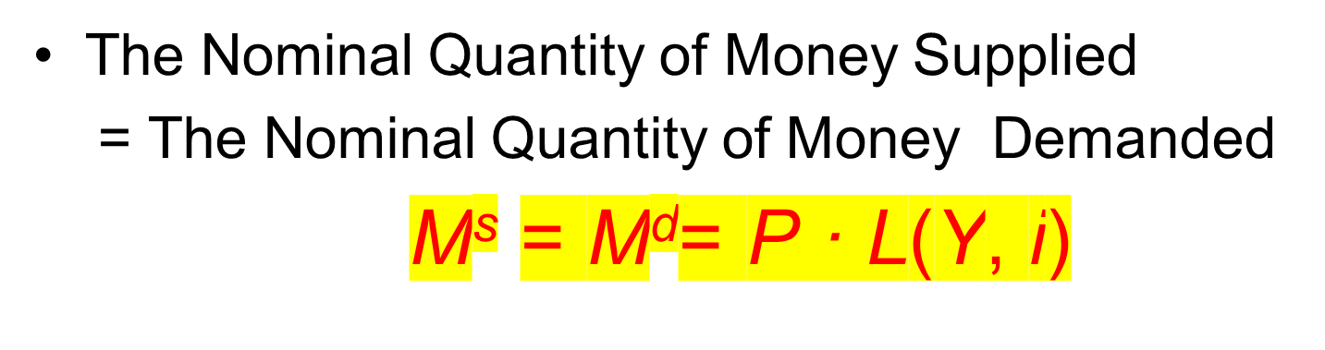
Determination of the Price Level

Slide 21
Determination of the Price Level
  一般性均衡：If we put all there equations together, we have three nominal prices—P, w, and R—adjust rapidly to ensure that three equilibrium conditions hold simultaneously:
    劳动力市场： L^{s} = L^{d}
    资本市场： (κK)^{s} = (κK)^{d}.
    货币市场： M^{s} = M^{d}
  This situation is referred to as one of general equilibrium (一般性均衡).

Slide 22
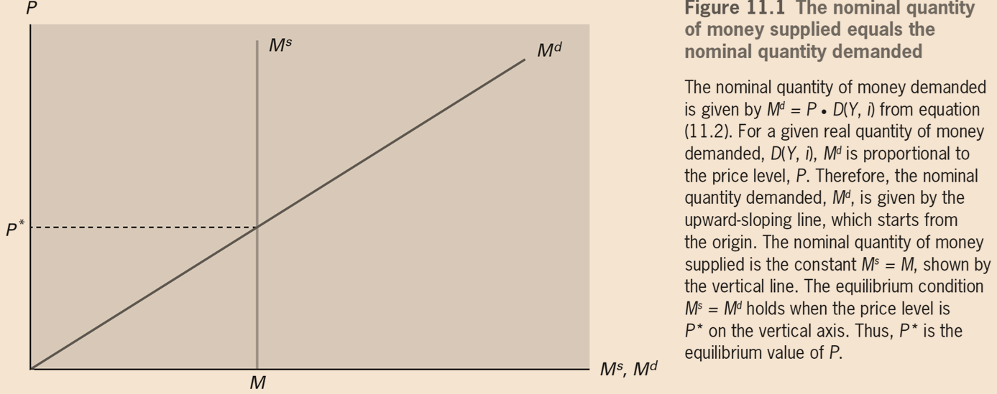
Determination of the Price Level

Slide 23
Determination of the Price Level
  The nominal quantity of money demanded is given by M^{d} = P · L(Y, i) . For a given real quantity of money demanded, L(Y, i) , M^{d} is proportional to the price level, P.
  Therefore, the nominal quantity demanded, M^{d}, is given by the upward-sloping line, which starts from the origin.
  The nominal quantity of money supplied is the constant M^{s} = M, shown by the vertical line.
  The equilibrium condition M^{s} = M^{d} holds when the price level is P* on the vertical axis. Thus, P* is the equilibrium value of P.

Slide 24
Determination of the Price Level
Change in the M^{s}
  From a one-time change in the nominal quantity of money supplied, M^{s}.
  The increase in M^{s} from M to 2M raises the equilibrium price level from P∗ to 2P∗

Slide 25
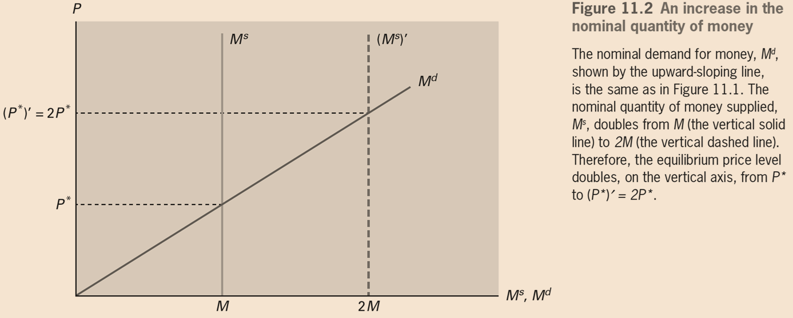
Determination of the Price Level

Slide 26
Determination of the Price Level
  The technology level, A, has not changed, （根据实际经济周期模型）so the real wage rate, w/P, and labor input, L, do not change.
  Since the price level, P, is twice as high, and w/P is unchanged, we conclude that, in general equilibrium, the nominal wage rate, w, has to be doubled.

Slide 27
Determination of the Price Level
  The unchanged technology level, A, （根据实际经济周期模型）means that the real rental price, R/P, and the quantity of capital services, κK, do not change.
  The fixed κK corresponds to a given capital stock, K, and an unchanged capital utilization rate, κ.
  Thus, the price level, P, is twice as high, and R/P is unchanged. We must have, in general equilibrium, that the nominal rental price, R, doubles.

Slide 28
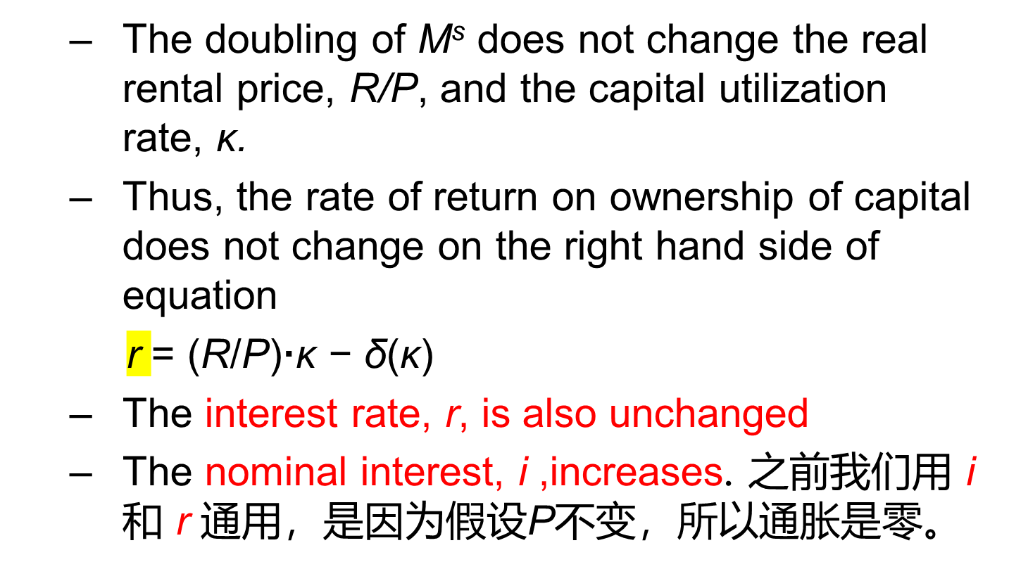
Determination of the Price Level

Slide 29
Determination of the Price Level
  A doubling of M^{s} does not affect the quantities of capital services, κK, and labor, L.
  In other words, in general equilibrium, a one-time increase in the nominal quantity of money supplied, M^{s}, does not affect real GDP.
  Y= A· F(κK, L)

Slide 30
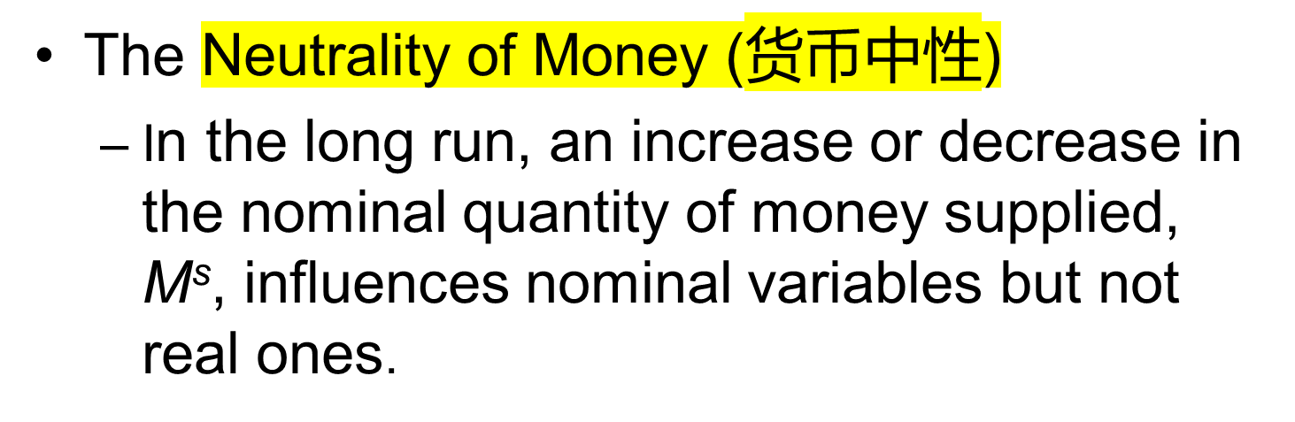
Determination of the Price Level

Slide 31
Determination of the Price Level
The Cyclical Behavior of the Price Level
  In a recession, in which real GDP, Y, falls.
    decline in Y reduces the real quantity of money demanded
    The decrease in i raises the real quantity of money demanded
  In a recession, the real quantity of money demanded, given by L(Y, i), decreases overall.

Slide 32
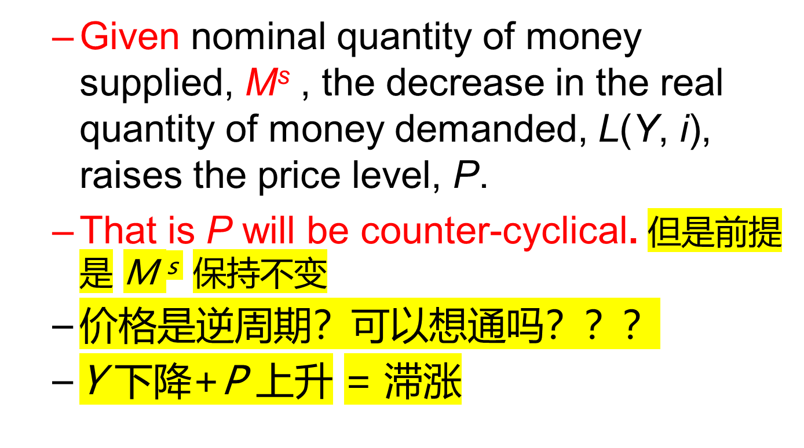
Determination of the Price Level

Slide 33
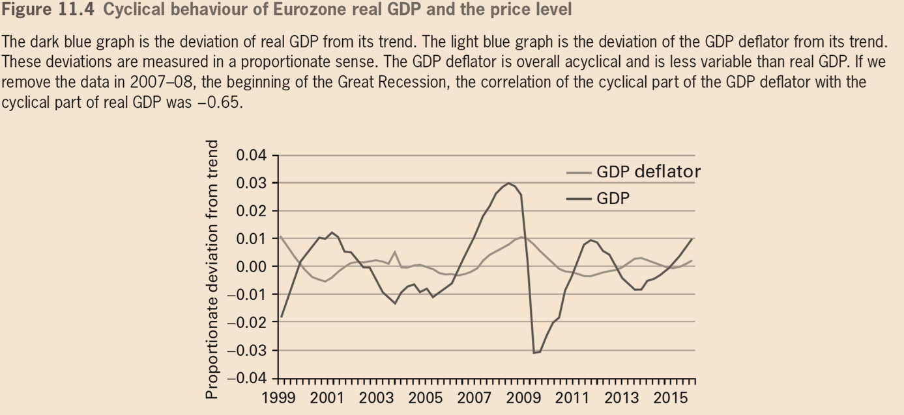
Determination of the Price Level

Slide 34
Determination of the Price Level
  In our equilibrium business cycle model, the underlying shocks come from the supply side (A as in the production function), not from the demand side.
  A low technology level, A—the source of a recession in the model—means that goods and services are in low supply.
  When looked at this way, it makes sense that P would tend to be high in a recession，if the money supply keeps

Slide 35
Determination of the Price Level
Price-Level Targeting and Endogenous Money
  When the monetary authority seeks to attain a specified price level, P₀, it typically has to adjust the nominal quantity of money supplied, M^{s}, in response to changes in the nominal quantity demanded, M^{d}.

Slide 36
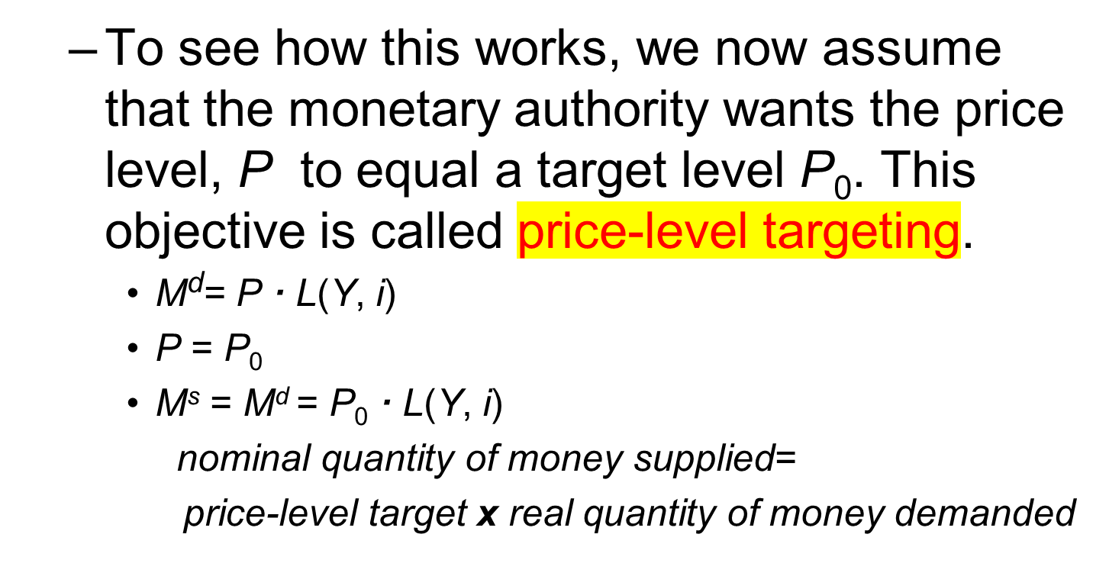
Determination of the Price Level

Slide 37
Determination of the Price Level
  Trend growth of money
    Since L(Y, i) grows at the same direction as real GDP, Y, we conclude that M^{s} must grow at the same direction as Y.
    Thereby, the growth rate of the nominal quantity of money, M^{s}, matches the growth rate of the real quantity demanded, L(Y, i) ,
    Would allow the price level, P, to remain constant at its target level, P₀.

Slide 38
Determination of the Price Level
  M should be procyclical.
    The cyclical fluctuations in M^{s} will match the cyclical fluctuations in the real quantity of money demanded L(Y, i) .
    Empirically, the nominal quantity of money, M^{s}, is weakly procyclical.

Slide 39
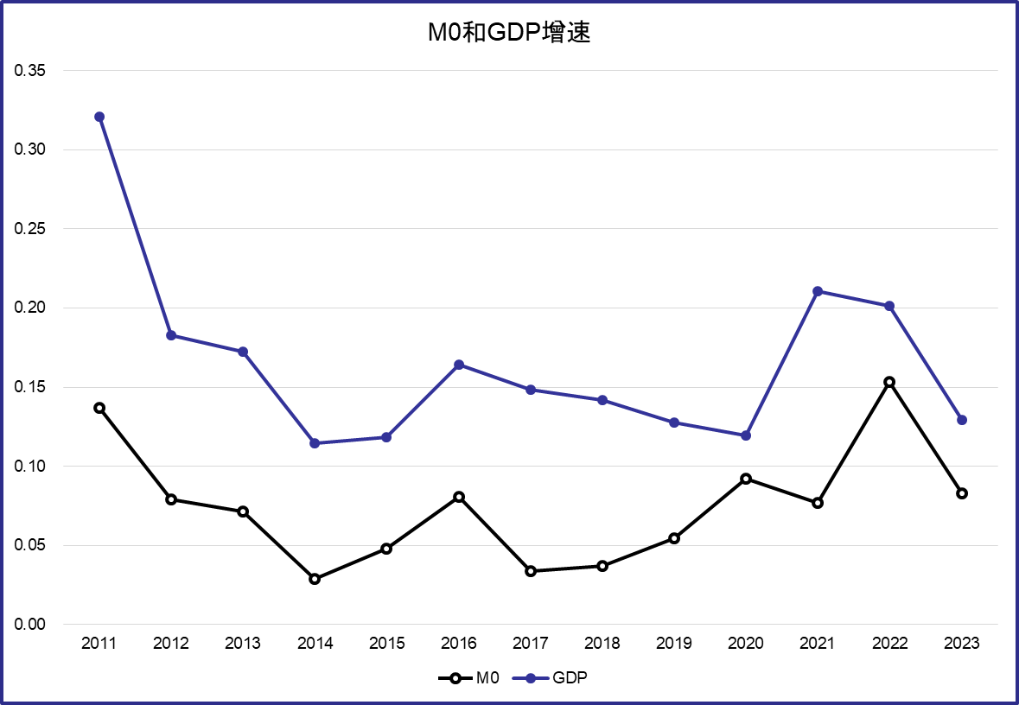

Slide 40
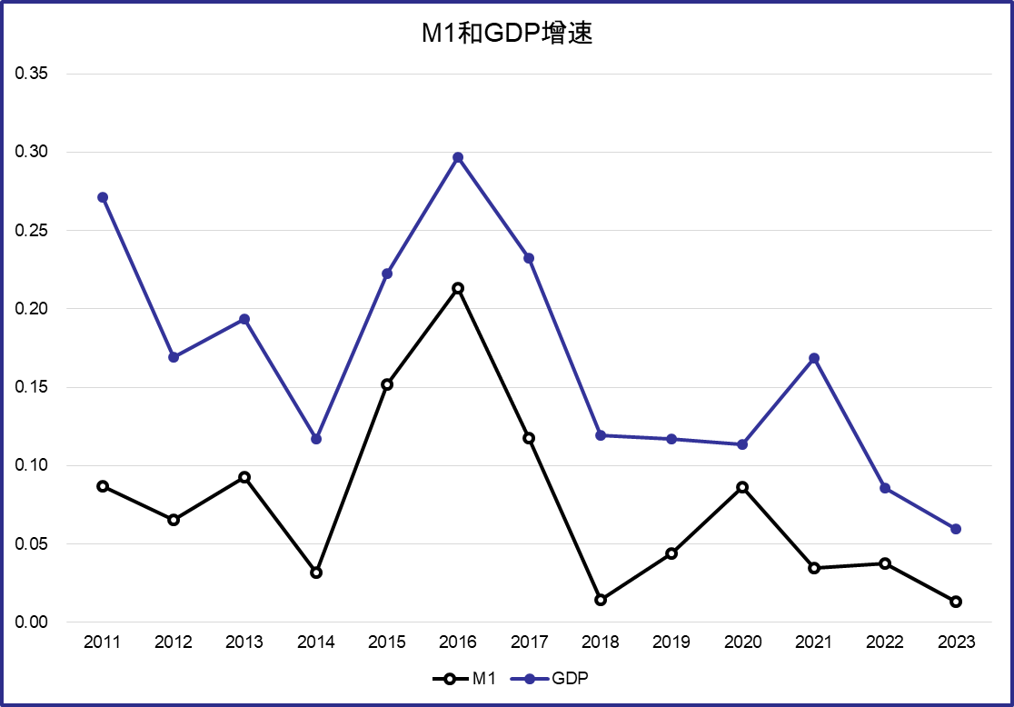

Slide 41
